Slide 1






AI + IoT BASED AUTOMATED ATTENDANCE & ACCESS-CONTROL SOLUTION
Smart Face Attendance and
Access Gate System
Using Face Recognition and Silicon Labs SiWG917
NAGALLA DURGA PRASAD 24H41A04A9
ROWTHU JAYASREE 24H41A04C0
VAKALAPALLI MEGHNA SRI ADITHYA LAKSHMI 24H41A04C8
BONAM VENKATA CHALAMAYYA INSTITUTE OF TECHNOLOGY AND SCIENCES
Department of Electronics and Communication Engineering
SMART FACE ATTENDANCE & ACCESS GATE SYSTEM
01

Slide 2





INTRODUCTION
Why Automated Attendance?
Attendance management is a routine but critical activity in educational institutions. Traditional methods still depend on manual processes that are slow and easy to manipulate.
Manual Roll Call
Traditional attendance relies on calling names, signatures or ID cards.
THE SOLUTION
Face Recognition Based
Automated Attendance
Time Consuming
Manual marking consumes valuable classroom / working time.
The proposed system introduces face-recognition technology into the attendance process, combining an AI software section with an IoT hardware section for automated, accurate and access-aware attendance.
Prone to Errors
Manual recording is vulnerable to human error and inconsistency.
Proxy Attendance
Signature and roll-call methods are open to proxy attendance.
SMART FACE ATTENDANCE & ACCESS GATE SYSTEM
02

Slide 3






OBJECTIVES
What the System Aims to Achieve
Automated Face-Recognition Attendance
Eliminate Manual Attendance
Student Registration
Facial Embedding-Based Identification
Date, Time, Status & Confidence Logging
One Attendance Record / Student / Day
Web-Based Dashboard
IoT Integration with SiWG917
RGB LED Status Indication
CSV Attendance Reports
Low-Cost, Scalable Design
SMART FACE ATTENDANCE & ACCESS GATE SYSTEM
03

Slide 4
SYSTEM OVERVIEW
System Architecture
Student
Webcam
Python /
FastAPI
OpenCV
InsightFace /
ONNX Runtime
Face
Embedding
Similarity
Matching
SQLite
Database
Attendance
Confirmation
Wi-Fi
SiWx917 /
BRD2605A
RGB LED /
Access
SOFTWARE / AI PIPELINE
IoT / HARDWARE PIPELINE
The software section performs detection, embedding and matching; the hardware section communicates over Wi-Fi with the SiWx917/BRD2605A board to drive the RGB status LED.
SMART FACE ATTENDANCE & ACCESS GATE SYSTEM
04

Slide 5


HARDWARE
Hardware Requirements
Silicon Labs SiWG917 / BRD2605A
Laptop / Computer
Webcam
IoT hardware interface; provides Wi-Fi connectivity and controls the RGB LED.
Main processing unit — face detection, embedding, database and web server.
Captures live images of students during attendance.
RGB LED
Wi-Fi Network
USB Cable
Visual status indication — blue / green / red.
Connects the attendance application with the SiWG917 board.
Programs and powers the development board during setup.
SMART FACE ATTENDANCE & ACCESS GATE SYSTEM
05

Slide 6
OBJECTIVES
What the System Aims to Achieve
Automated Face-Recognition Attendance
Eliminate Manual Attendance
Student Registration
Facial Embedding-Based Identification
Date, Time, Status & Confidence Logging
One Attendance Record / Student / Day
Web-Based Dashboard
IoT Integration with SiWG917
RGB LED Status Indication
CSV Attendance Reports
Low-Cost, Scalable Design
SMART FACE ATTENDANCE & ACCESS GATE SYSTEM
03

Slide 7



AI PIPELINE
Face Recognition Process
Image
Face Detection
Face Embedding
Similarity Comparison
Student Identification
Attendance Decision
Registered facial embeddings are compared against the query embedding generated from the live webcam image. A similarity score is calculated between the two normalized embedding vectors, and a configurable matching threshold decides whether the face is recognized.
SMART FACE ATTENDANCE & ACCESS GATE SYSTEM
07

Slide 8
WORKFLOW
Complete System Workflow
Register Student
Generate & Store Embedding
(SQLite)
Start Live Attendance
Capture Webcam Image
Detect Face &
Generate Query Embedding
Compare with Registered
Embeddings + Similarity Score
Face
Recognized?
YES
NO
Identify Student
Unknown Face
Check Today's Attendance
Attendance Not Recorded
Record Attendance
(Date, Time, Confidence)
IoT Status → RED /
No Access Signal
Send IoT Authorization Command
SiWG917 RGB LED → GREEN
SMART FACE ATTENDANCE & ACCESS GATE SYSTEM
08

Slide 9




IOT COMMUNICATION
IoT Communication & RGB LED
Wi-Fi Communication
The backend communicates with the IoT hardware using HTTP over Wi-Fi.
SiWx917 HTTP Server
The board binds and starts a lightweight HTTP server and waits for commands.
SiWx917 / BRD2605A
/health Endpoint
RGB LED STATUS INDICATION
Used to check whether the SiWG917 board is online.
BLUE
Normal / Idle state
/led Endpoint
GREEN
Recognized / Authorized student
Accepts a colour command — red, green or blue — to drive the RGB LED.
RED
Unknown person / Error condition
API-Key Authentication
Authenticated access is required to prevent unauthorized control requests.
SMART FACE ATTENDANCE & ACCESS GATE SYSTEM
09

Slide 10
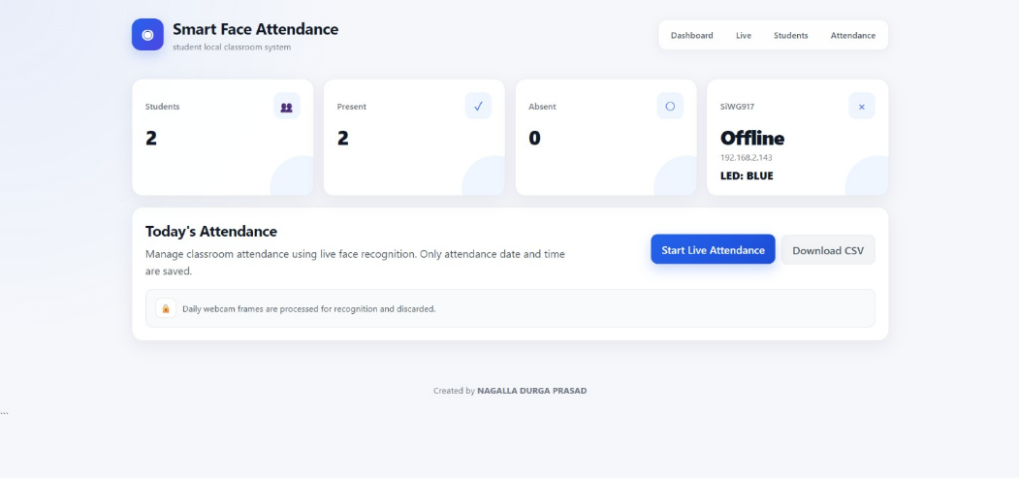
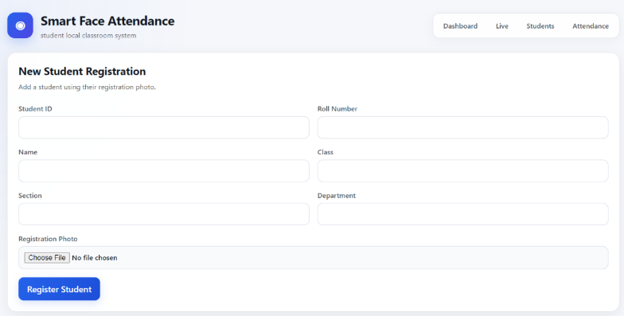
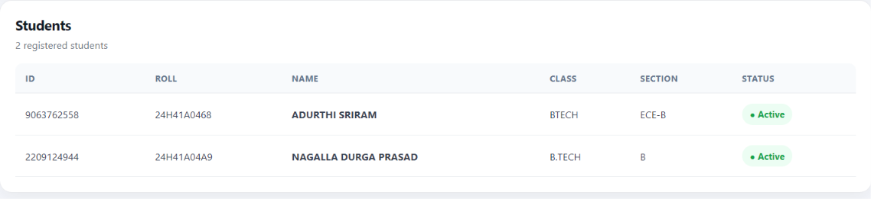
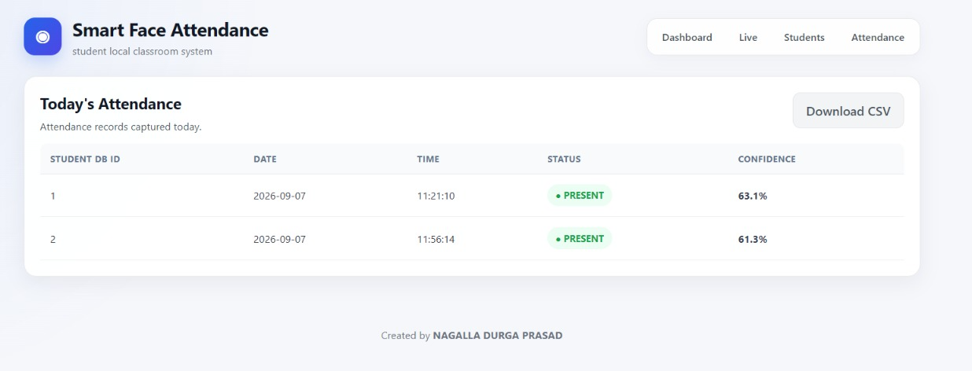
WEB APPLICATION
Web Dashboard
Student Registration
Dashboard — statistics, IoT device status & today's attendance
Registered Students List
Attendance Records & CSV Download
SMART FACE ATTENDANCE & ACCESS GATE SYSTEM
10

Slide 11



END-TO-END FLOW
Data Flow
Student
Webcam
Python /
FastAPI
OpenCV
InsightFace /
ONNX Runtime
Face
Embedding
Similarity
Matching
SQLite
Attendance
Confirmation
Wi-Fi
SiWx917 /
BRD2605A
RGB LED
Status
Student → Camera → Face Recognition → Attendance Database → Wi-Fi → SiWx917 → RGB LED / Access Indication
SMART FACE ATTENDANCE & ACCESS GATE SYSTEM
11

Slide 12
OUTPUT & RESULTS
Output Result
SIMPLICITY STUDIO CONSOLE
SiWG917 Face Attendance Application
BRD2605A — Application Started
RGB LED initialized
Normal state: BLUE
Initializing Wi-Fi...
Wi-Fi interface initialized
Wi-Fi connected successfully!
SiWG917 IPv4 Address: 192.168.2.143
Binding HTTP server...
HTTP server initialized
HTTP SERVER STARTED — PORT: 80
DEVICE: SiWG917 + BRD2605A — STATUS: ONLINE
/health?key=<API_KEY>
/led?color=red|green|blue&key=<API_KEY>
FACE ATTENDANCE GATE READY
Web Dashboard
Wi-Fi connected successfully
HTTP server started — device online
Registered students recognized with confidence score
Attendance recorded with date, time & status
SMART FACE ATTENDANCE & ACCESS GATE SYSTEM
12

Slide 13









APPLICATIONS
Applications & Future Scope
APPLICATIONS
FUTURE SCOPE
Educational Institutions
Offices
The architecture can be expanded from an RGB indicator toward physical access control:
Laboratories
Libraries
Electronic Door / Gate Control
Relay Modules
Examination Centres
Hostels
Servo Motors
Smart Access-Control Systems
Smart Campus
Automatic Doors
Multiple Cameras
Centralized Attendance Management
SMART FACE ATTENDANCE & ACCESS GATE SYSTEM
13

Slide 14
CONCLUSION
Bringing AI and IoT Together
AI-based facial identification for accurate, automated attendance
Student details and facial embeddings maintained in SQLite
IoT hardware integration via Silicon Labs SiWG917 / BRD2605A
Reliable Wi-Fi communication between software and board
RGB LED status feedback for instant visual confirmation
A scalable concept for access-control automation
Thank You
SMART FACE ATTENDANCE & ACCESS GATE SYSTEM
14

